Slide 1

Color Palate
#00B0F0
#F2F2F2
#FF5969
#F7F7F7
Background
#52C9BD
#D9D9D9
#FEC630
#5D7373
#92D050
#7F7F7F
#05E1E7
#404040
Basically for text

Slide 2
JS
RegistrationUserForm
FormSection1
FormSection2
FormSection3
InputField
PasswordField
OtpField
ImageUploadField
FileUpload
Button
AlertContainer
Alert
CSS
RegistrationUserForm
InputField
PasswordField
OtpField
FileUpload
Button
Alert
Helper
generateID
generateOTP
generatePasscode
Validation
Notes:
Registration

Slide 3
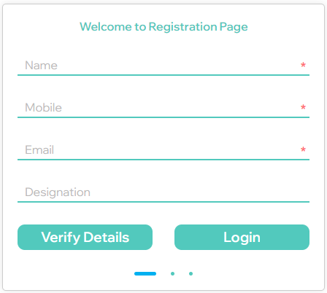
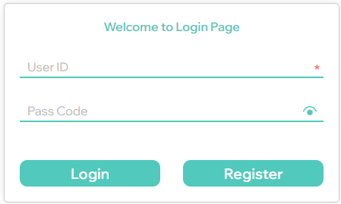
Notes:
Login

Slide 4
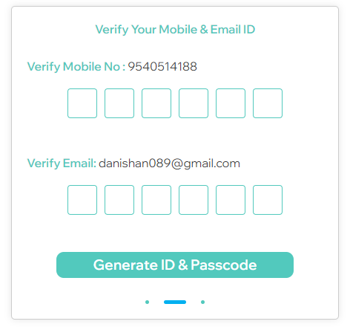
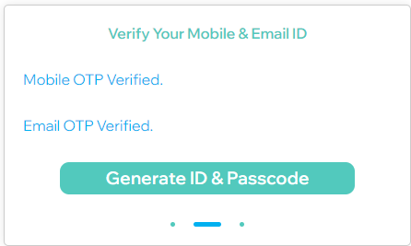
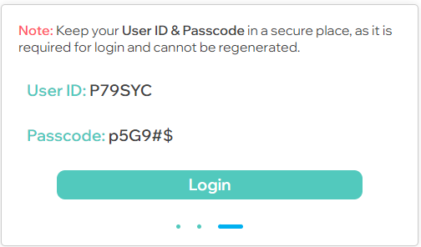
Notes:
Registeration

Slide 5
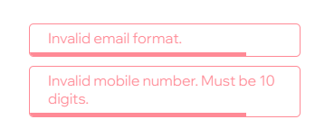

Notes:
Errors & Success

